Slide 1
DORANet Workshop
Quan Zhang, Stefan Pate, William Sprague
Prof. Linda Broadbelt
Northwestern University
June 26, 2024

Slide 2
Background: CASP with DORAnet

Slide 3



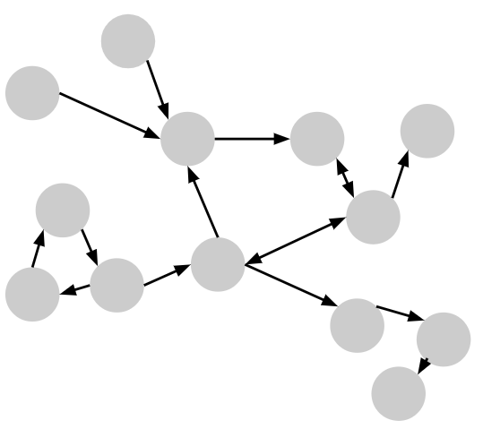
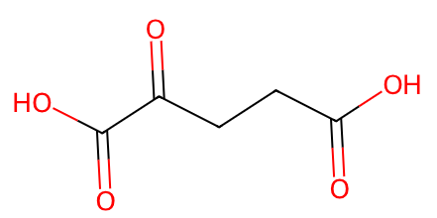
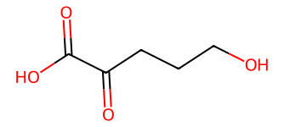
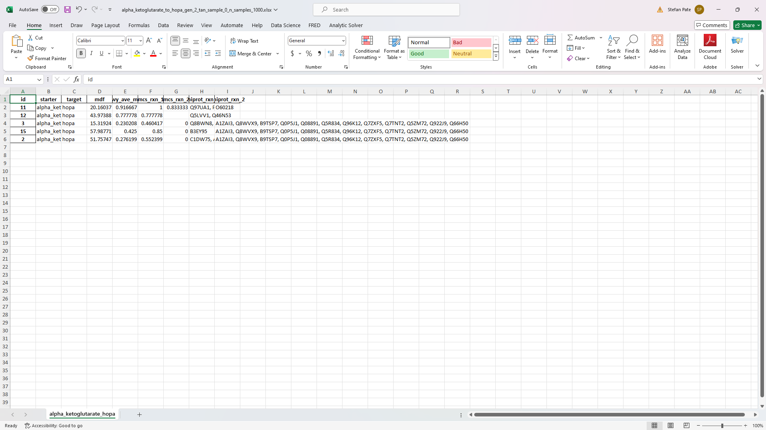
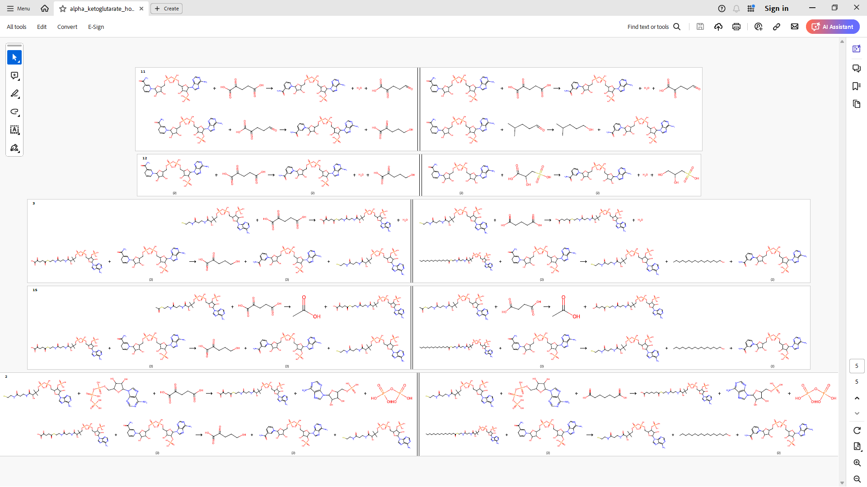
Overview of CASP with DORAnet
1
D
,
,
→
starting molecules
target molecules
operators
2
→
Filtering &
post-processing
→

Slide 4
Background: Operators

Slide 5
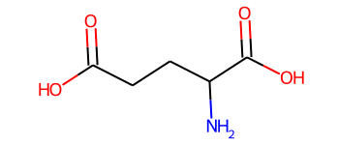
First, let’s consider CASP without operators
Glutamate synthase
(1.4.1.14)
This network of known enzymatic reactions is incomplete…

Slide 6
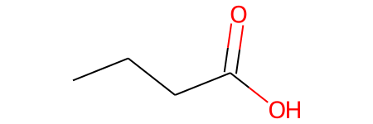
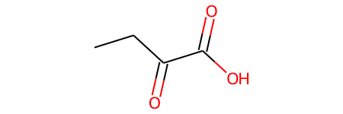
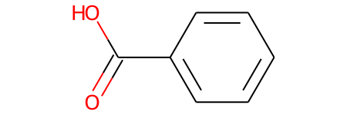
One-enzyme-one-substrate gives way to enzyme promiscuity
ILLUSTRATIVE
Enzyme: NICar
K_{cat} / K_{M}
Enzymes catalyze reactions on more than one substrate
Catalytic efficiency is similar for structurally similar substrates
Substrate structure
Tawfik, 2010. Ann. Rev. Biochem.
Arnold, 2018. Ang. Chem. Int.

Slide 7
One-enzyme-one-substrate gives way to enzyme promiscuity
ILLUSTRATIVE
Enzyme: NICar
K_{cat} / K_{M}
Enzymes catalyze reactions on more than one substrate
Catalytic efficiency is similar for structurally similar substrates
Substrate structure
Tawfik, 2010. Ann. Rev. Biochem.
Arnold, 2018. Ang. Chem. Int.

Slide 8
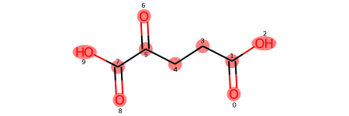
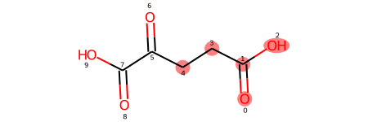
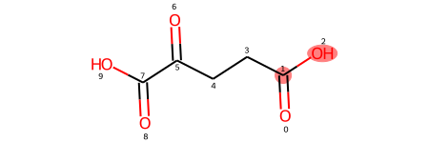
Enzymatic operators codify these two assumptions…
PERMISSIVENESS
CATALYTIC EFFICIENCY
r=inf
r=2
r=0
substructure:
# known compounds w/ matching substructure:
8
3,250
7,759

Slide 9
…allowing a search among predicted missing paths
Default enzymatic operators in DORAnet assume intermediate level of promiscuity

Slide 10
[Quan on construction of the chemical operators]

Slide 11
[Quan on forward versus retro & combination of both]

Slide 12
Installation: DORAnet

Slide 13
Virtual Environment
Miniconda or Anaconda Installation
Download the installer
Miniconda https://docs.anaconda.com/free/miniconda/
Anaconda https://docs.anaconda.com/free/anaconda/install/
Run the installer
Follow the on-screen instructions
Use conda with command line
Linux and mac: open the built-in terminal
Windows: open the Anaconda Powershell Prompt

Slide 14
Create and Activate an Environment
If you already have an environment to install DORAnet
If you want to create a new environment to install DORAnet
conda activate your_env_name
conda create -n your_env_name python=3.10
conda activate your_env_name

Slide 15
Install DORAnet
Install
Update DORAnet (In the Future)
pip install doranet
pip install doranet --upgrade

Slide 16
Demo: Network expansion

Slide 17
We’ll demonstrate DORAnet w/ 2 paths predicted for BOTTLE
Bio
(2 steps)
Chem
Placeholder Quan’s chem path to demo

Slide 18
[Instructions how run expansion – mirror the colab markdown]

Slide 19
Background: post-processing

Slide 20
We saw w/ just 2 steps how quickly the reaction count grows
Bio
156,000 reactions
(2 steps)
Chem
Placeholder Quan’s chem path to demo
xxxx reactions
Estimated average # of predicted reactions: 1,348 ± 91 for bio operators alone

Slide 21
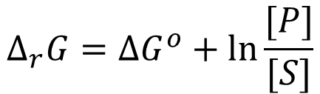
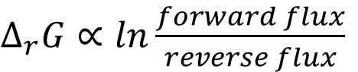
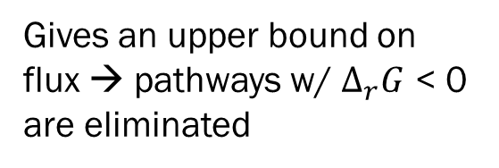
Most helpful filters: (1) thermodynamics
$Δ_{r}G∝ln\frac{forward flux}{reverse flux}$
$$Δ_{r}G=ΔG^{o}+ln⁡\frac{[P]}{[S]}$$
Gives an upper bound on flux → pathways w/ $Δ_{r}G$ < 0 are eliminated
Property of the substrates → estimate with group contribution theory
Function of substrate concentrations → optimize within physiological constraints
Noor et al., 2014. PLoS Comp. Bio.
Beard & Qian, 2007. PLoS ONE.

Slide 22
Most helpful filters: (2) structural similarity to known substrate
Placeholder side by side of akg with known reaction / sub w/ rcmcs highlighted. Could do a high value and low value example…

Slide 23
[Quan on his most useful filters]

Slide 24
Demo: Post-processing

Slide 25
[Instructions how read Stefan’s / Quans deliverable optional run of Quan’s filtering]

Slide 26
Coming soon: [Hybrid pathways, kinetics…]

Slide 27
[William highlight new things in development]

Slide 28
Questions

Slide 29
Backup

